Slide 1
Parallelization and runtime optimization

Slide 2
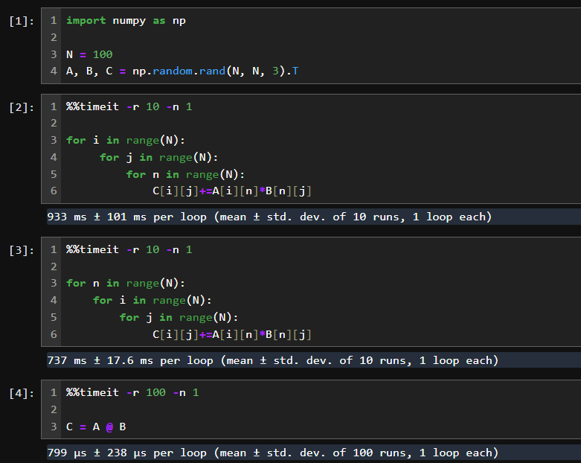
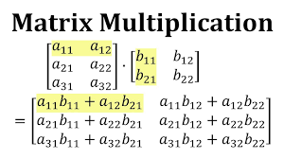
Algorithmic optimization and outsourcing
A great and simple example of algorithmic optimization is the naive matrix multiplication. *jupyter notebook for reference*

Slide 3
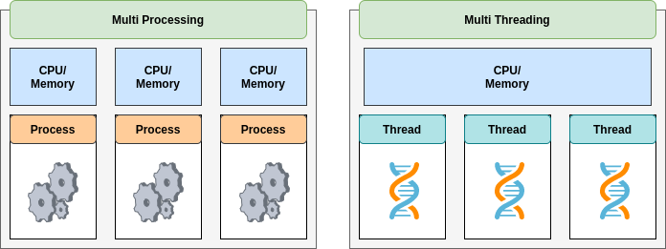
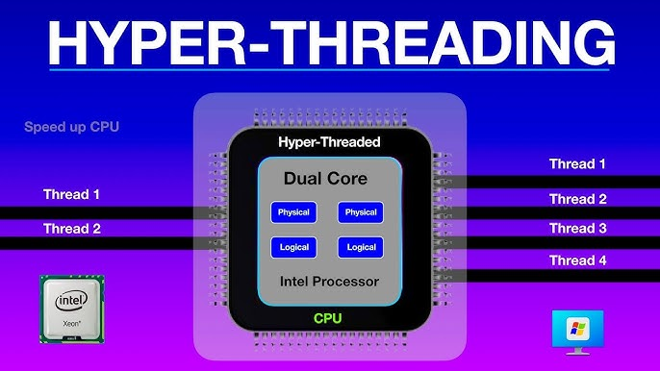
Three depth levels of parallelization

Slide 4
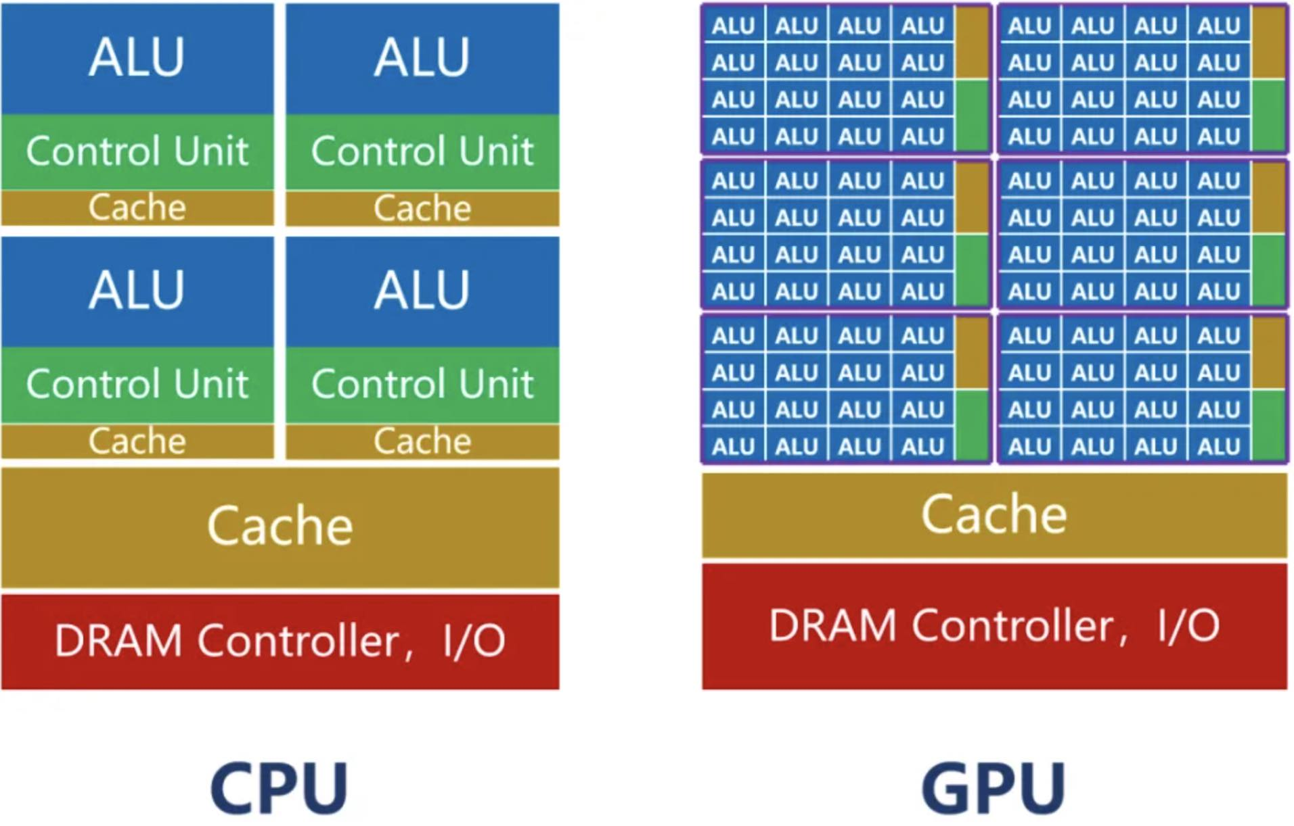
CPU vs GPU

Slide 5
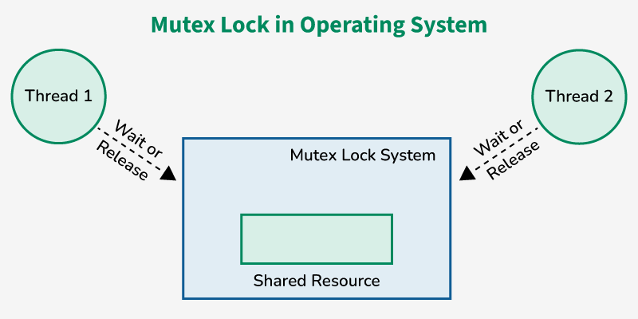
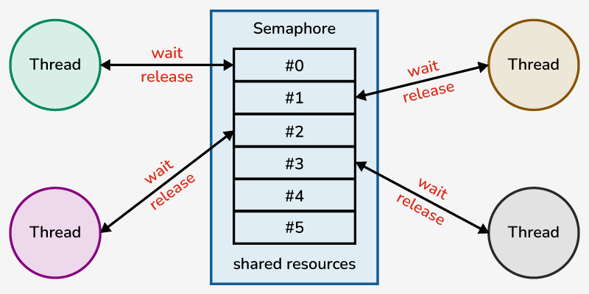
Core parallelization concepts
Daemon Processes/Threads - Background processes that terminate when the main program exits
Locks/Mutexes: Ensure only one thread accesses a resource at a time.
Semaphores- Limit access to a resource to N threads.
Barriers- Threads wait until all reach a certain point before proceeding.
Deadlocks- two or more processes block forever, each holding a resource the other needs
Race Conditions- conditions of memory (rights) access between processes/threads
Load Balancing

Slide 6
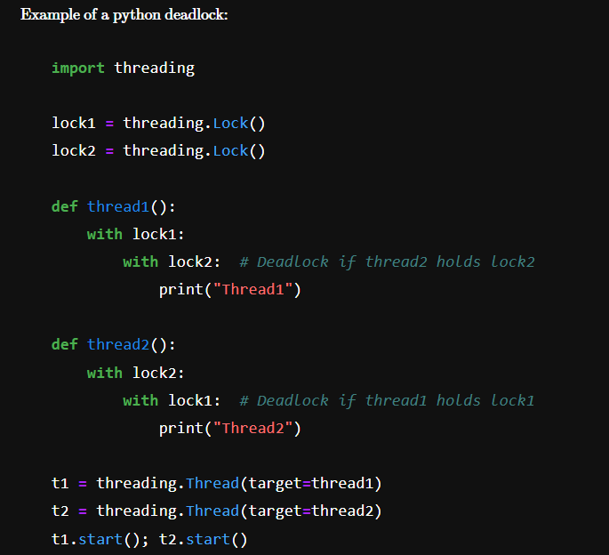

Slide 7






Parallelization frameworks
multiprocessing
threading

Slide 8
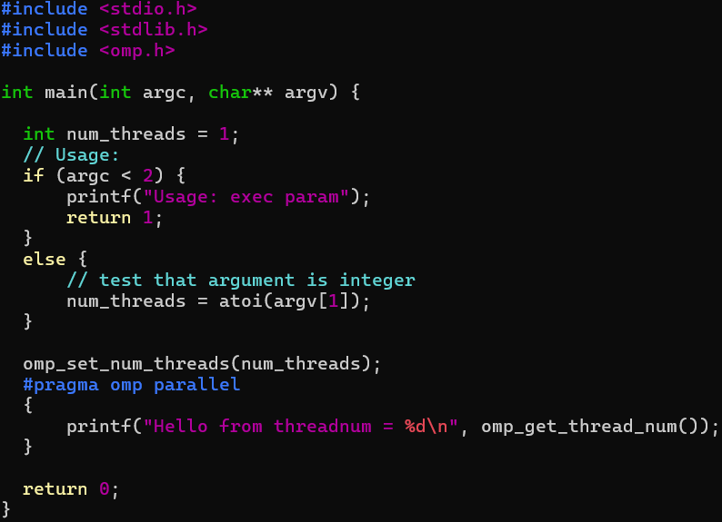
Time to look at some real code
Snippet that calls for each process *smooth transition to jupyter notebook*

Slide 9
Neuromorphic Computing
Neuromorphic computing is a broad concepts that refers to anything that relates to the computation using either live neurons or architectures that mimic the neural structure of human brain. Today we’ll take a look at the Loihi neuromorphic chip designed by Intel, its performance and use in video and signal processing tasks

Slide 10
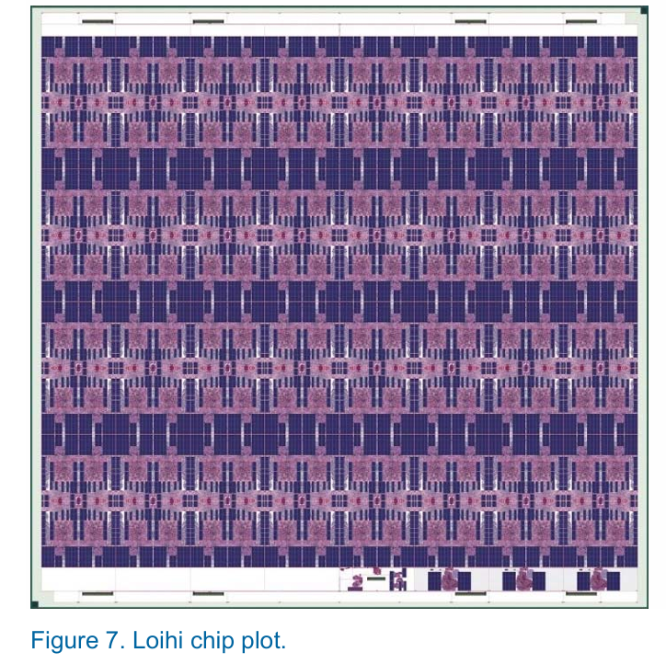
Loihi architecture
Loihi novelty:
Sparse network compression
Core-to-core multicast
Variable synaptic formats
Population-based hierarchical connectivity
Notes:
Loihi is essentially a neuromorphic chip hooked up to the classical architecture control units. It features 128 neuromorphic cores and 3 classical (x86) cores. Each neuromorphic core implements 1024 primitive SNN units. The novelty of the device is that it supports the following features for ease of computation
• Sparse network compression. Besides a common dense matrix connectivity model, Loihi supports three sparse matrix compression models in which fan-out neuron indices are computed based on index state stored with each synapse’s state variables.
• Core-to-core multicast. Any neuron may direct a single spike to any number of destina tion cores, as the network connectivity might require.
• Variable synaptic formats. Loihi supports any weight precision between one and nine bits, signed or unsigned, and weight precisions may be mixed (with scale normalization) even within a single neuron’s fan-out distribution.
• Population-based hierarchical connectivity. As a generalized weight-sharing mecha nism, such as to support convolutional neural network types, connectivity templates may be defined and mapped to specific population instances during operation. This fea ture can reduce a network’s required connectivity resources by over an order of magni tude.

Slide 11
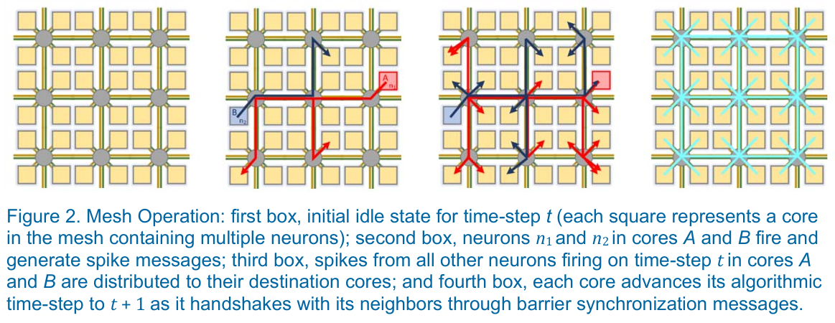
Mesh operation and synchronization
Notes:
Text directly copied from the paper (for reference!!!!)
The NoC distributes spike (and all other) messages according to a dimension-order routing algorithm. The NoC itself only supports unicast distributions.
To multicast spikes, the output process of each core iterates over a list of destination cores for a firing neuron’s fan-out distribution and sends one spike per core.
For deadlock protection reasons relating to read and chip-to-chip message transactions, the mesh uses two independent physical router networks.
For bandwidth efficiency, the cores alternate sending their spike messages across the two physical networks. At the end of the time-step, a mechanism is needed to ensure that all spikes have been delivered and that it’s safe for the cores to proceed to time-step t + 1. Rather than using a globally distributed time reference (clock) that must prepare for the worst-case chip-wide network activity, we use a barrier synchronization mechanism, illustrated in the fourth box.
As each core finishes servicing its compartments for time-step t, it exchanges barrier messages with its neighboring cores. The barrier messages flush any spikes in flight and, in a second phase, propagate a time-step advance notification to all cores. As cores receive the second phase of barrier messages, they advance their time-step and proceed to update compartments for time t + 1. As long as management activity is restricted to a specific “preemption” phase of the barrier synchronization process that any embedded x86 core or off-chip host may introduce on demand, the Loihi mesh is provably deadlock free.

Slide 12
Constraints
Loihi architecture can support arbitrary multigraph networks subject to the cores’ resource constraints:
The total number of neurons assigned to any core may not exceed 1,024 (N_cx)
The total synaptic fan-in state mapped to any core must not exceed 128 KB (N_syn × 64b, subject to compression and list alignment considerations)
The total number of core-to-core fan-out edges mapped to any given core must not exceed 4,096 (N_axout)
The total number of distribution lists, associated by axon_id, in any core must not exceed 4,096 (N_axin)
Notes:
In practice, constraints 2 and 4 tend to be the most limiting

Slide 13
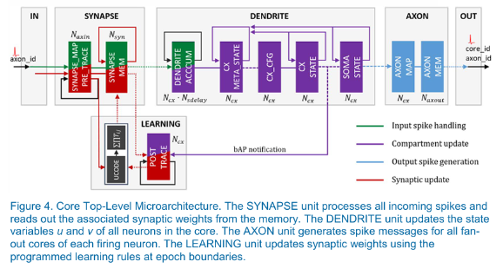
The architecture of the neuromorphic cores
Notes:
text from the paper (for reference!!!) The internal structure of the Loihi neuromorphic core is presented above. Colored blocks in this diagram represent the major memories that store the connectivity, configuration, and dynamic state of all neurons mapped to the core. The core’s total SRAM capacity is 2 Mb, including ECC overhead. The coloring of memories and dataflow arcs illustrates the core’s four primary operating modes: input spike handling (green), neuron compartment updates (purple), output spike generation (blue), and synaptic updates (red). Each of these modes operates independently with minimal synchronization at a variety of frequencies, based on the state and configuration of the core. The black structure marked UCODE represents the configurable learning engine. The values annotated by each memory indicate its number of logical addresses, which correspond to the core’s major resource constraints. The number of input and output axons (N_axin and N_axout), the synaptic memory size (N_syn), and the total number of neuron compartments (N_cx) im pose network connectivity constraints, as described earlier. The parameter Nsdelay indicates the minimum number of synaptic delay units supported, eight in Loihi. Larger synaptic delay values, up to 62, may be supported when fewer neuron compartments are needed by a particular mapped network.

Slide 14
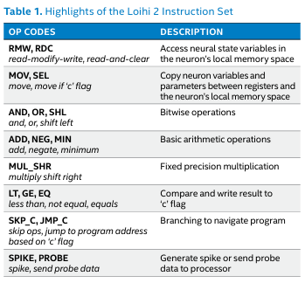
Loihi 2. Novelty
List of the new features:
Loihi 2 supports fully programmable neuron models with graded spikes
Support for three-factor learning rules
Notes:
Loihi 2 supports fully programmable neuron models with graded spikes.
Each neuron model takes the form of a program, which is a short sequence of microcode instructions describing the behavior of a single neuron. The microcode instruction set supports bitwise and basic math operations in addition to conditional branching, memory access, and specialized instructions for spike generation and probing. Table 1 summarizes the different types of instructions. Neurons can optionally generate and transmit graded spikes—a generalization of Loihi’s binary spike messages— that carry a 32-bit spike payload, specified by microcode. A graded spike’s integer-valued payload multiplies the weights of downstream synapses. Typically, only eight bits of precision are used, representing a negligible extra energy cost compared to binary spike processing.
Support for three-factor learning rules. Loihi 2 programmable neuron models may now manipulate synaptic input received from its dendritic compartments with arbitrary microcode and assign the results to third factor modulatory terms available to a neuron’s synaptic learning rules. This greatly generalizes the support Loihi offered for a reward based broadcast mechanism that was intended for the same purpose of modulating learning rules. Loihi 2’s modulatory factors may be mapped uniquely per post-synaptic neuron, such as to represent errors that apply to individual neurons in support of supervised learning algorithms.

Slide 15
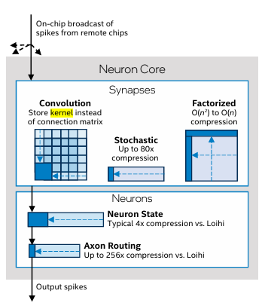
Notes:
Capacity Improvements
Loihi 2 achieves a 2x higher synaptic density than Loihi. Compared to Loihi, the Loihi 2 neuron cores are approximately half the size for a similar synaptic memory capacity. Although each Loihi 2 core has slightly less aggregate memory, the effective core capacity is significantly higher because the memory architecture in Loihi 2 is more efficient.
Loihi 2 cores support flexible memory partitioning to increase the effective core capacity. Where Loihi used many discrete individual memories, each with a fixed allocation, Loihi 2 asynchronously aggregates its memories to allow different functions in the core to access a variable number of memory banks (see Figure 2). This allows the overall memory resources to be soft-partitioned in order to achieve the optimal balance for a particular application— for instance, between neurons and synapses—on a per-core basis. This results in a higher effective core capacity. For example, the most common configuration of a Leaky-Integrate-and-Fire neuron model requires 4x fewer memory resources in Loihi 2 compared to Loihi. In this case, Loihi 2 can implement 4x the neurons in the same memory footprint. Even greater neuron density can be achieved by reducing neuron precision or by reclaiming memory from other features.
Loihi 2 offers advanced connectivity compression features to better utilize available memory. Loihi 2 still supports the various sparse and dense synapse encodings supported by Loihi, but longer synapse lists and more flexibility in synaptic precision results in more efficient synapse encoding. Bigger improvements come from Loihi 2’s support for convolutional, factorized, and stochastic connections. Loihi 2’s convolution feature supports strided, dilated, and sparse kernels. The kernel is only stored once on the core, with synaptic targets computed on-the-fly. The factorized connectivity feature can compress synaptic memory from O(n2) to O(n) when the connectivity matrix can be expressed as the product of two vectors. Finally, the stochastic connectivity feature supports the procedural generation of synapses from a single seed. These powerful new features can increase effective synaptic capacities by many factors; for example, 17x for some convolutional networks to over 80x for stochastic connections.
Loihi 2 increases the number of embedded processors per chip to 6 from 3 in Loihi. These processors are programmed with conventional C or Python code and perform many essential tasks related to encoding and decoding data across the neuromorphic domain, as well as management and housekeeping operations. The increased processor count helps to prevent these conventional processing tasks from bottlenecking overall application performance, as occasionally occurred in Loihi.
I/O and Scalability
Loihi 2 supports local broadcast of spikes at a destination chip to alleviate congestion on chip-to-chip channels. Inter-chip links are fewer in number and inherently slower than on-chip links, thus introducing a potential bottleneck through which all inter-chip traffic must flow. Loihi 2’s new local broadcast feature significantly reduces inter-chip traffic, which can result in increases of over 10x in effective bandwidth for multi-chip workloads while freeing up routing table resources in the sending core.
Loihi 2 supports 3D multi-chip scaling, resulting in shorter routing distances between chips and further reducing the congestion of inter-chip links. A variety of asynchronous inter-chip protocols optimized for different distances and pin-counts is available to allow flexibility in building systems of chips with different densities and physical configurations.
Loihi 2 supports standard interfaces for easier system integration with non-Loihi devices. Supported interfaces include 1000BASE-KX, 2500BASE-KX and 10GBase KR Ethernet, GPIO, and both synchronous (SPI) and asynchronous (AER) handshaking protocols. A spike I/O module at the edge of the chip provides configurable hardware accelerated expansion and encoding of input data into spike messages, reducing the bandwidth required from the external interface and improving performance while reducing load on the embedded processors.

Slide 16
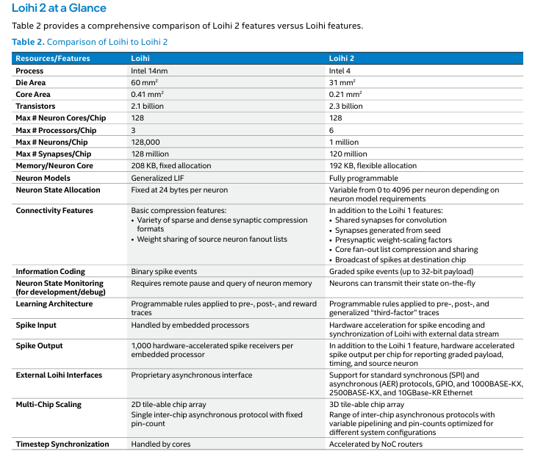
Notes:
Capacity Improvements
Loihi 2 achieves a 2x higher synaptic density than Loihi. Compared to Loihi, the Loihi 2 neuron cores are approximately half the size for a similar synaptic memory capacity. Although each Loihi 2 core has slightly less aggregate memory, the effective core capacity is significantly higher because the memory architecture in Loihi 2 is more efficient.
Loihi 2 cores support flexible memory partitioning to increase the effective core capacity. Where Loihi used many discrete individual memories, each with a fixed allocation, Loihi 2 asynchronously aggregates its memories to allow different functions in the core to access a variable number of memory banks (see Figure 2). This allows the overall memory resources to be soft-partitioned in order to achieve the optimal balance for a particular application— for instance, between neurons and synapses—on a per-core basis. This results in a higher effective core capacity. For example, the most common configuration of a Leaky-Integrate-and-Fire neuron model requires 4x fewer memory resources in Loihi 2 compared to Loihi. In this case, Loihi 2 can implement 4x the neurons in the same memory footprint. Even greater neuron density can be achieved by reducing neuron precision or by reclaiming memory from other features.
Loihi 2 offers advanced connectivity compression features to better utilize available memory. Loihi 2 still supports the various sparse and dense synapse encodings supported by Loihi, but longer synapse lists and more flexibility in synaptic precision results in more efficient synapse encoding. Bigger improvements come from Loihi 2’s support for convolutional, factorized, and stochastic connections. Loihi 2’s convolution feature supports strided, dilated, and sparse kernels. The kernel is only stored once on the core, with synaptic targets computed on-the-fly. The factorized connectivity feature can compress synaptic memory from O(n2) to O(n) when the connectivity matrix can be expressed as the product of two vectors. Finally, the stochastic connectivity feature supports the procedural generation of synapses from a single seed. These powerful new features can increase effective synaptic capacities by many factors; for example, 17x for some convolutional networks to over 80x for stochastic connections.
Loihi 2 increases the number of embedded processors per chip to 6 from 3 in Loihi. These processors are programmed with conventional C or Python code and perform many essential tasks related to encoding and decoding data across the neuromorphic domain, as well as management and housekeeping operations. The increased processor count helps to prevent these conventional processing tasks from bottlenecking overall application performance, as occasionally occurred in Loihi.
I/O and Scalability
Loihi 2 supports local broadcast of spikes at a destination chip to alleviate congestion on chip-to-chip channels. Inter-chip links are fewer in number and inherently slower than on-chip links, thus introducing a potential bottleneck through which all inter-chip traffic must flow. Loihi 2’s new local broadcast feature significantly reduces inter-chip traffic, which can result in increases of over 10x in effective bandwidth for multi-chip workloads while freeing up routing table resources in the sending core.
Loihi 2 supports 3D multi-chip scaling, resulting in shorter routing distances between chips and further reducing the congestion of inter-chip links. A variety of asynchronous inter-chip protocols optimized for different distances and pin-counts is available to allow flexibility in building systems of chips with different densities and physical configurations.
Loihi 2 supports standard interfaces for easier system integration with non-Loihi devices. Supported interfaces include 1000BASE-KX, 2500BASE-KX and 10GBase KR Ethernet, GPIO, and both synchronous (SPI) and asynchronous (AER) handshaking protocols. A spike I/O module at the edge of the chip provides configurable hardware accelerated expansion and encoding of input data into spike messages, reducing the bandwidth required from the external interface and improving performance while reducing load on the embedded processors.

Slide 17
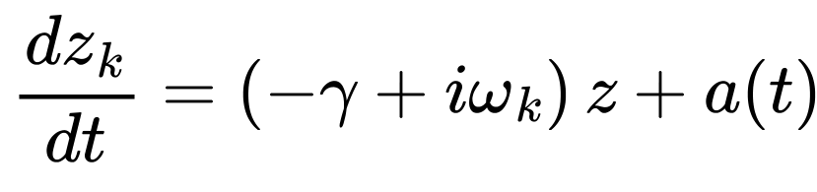
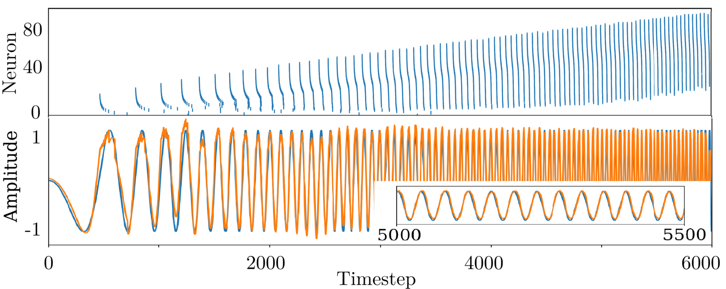
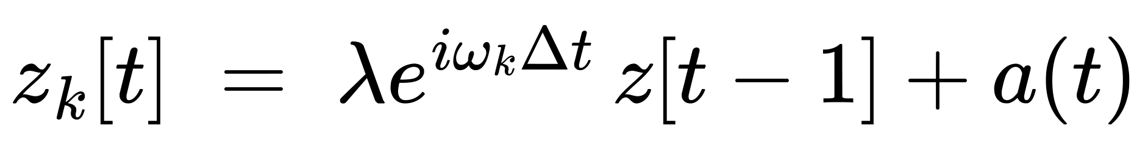
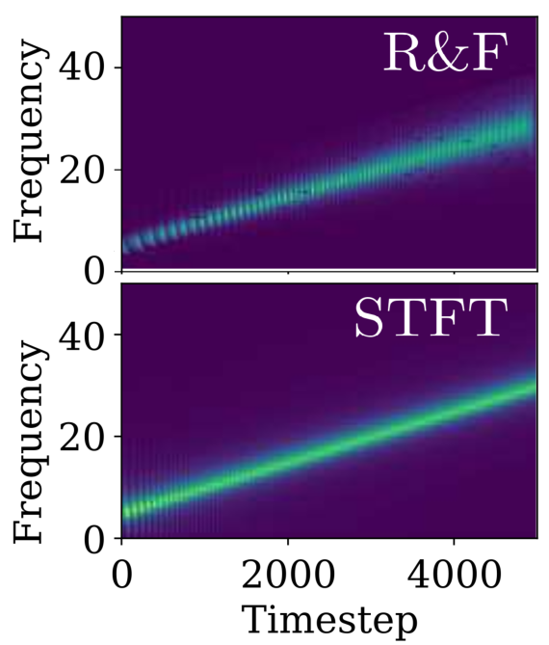
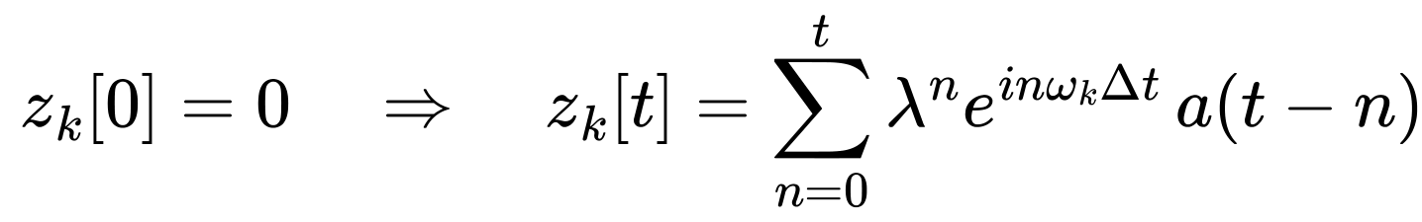
Resonate-and-Fire (RF) model
Figure: spiking patterns of 100-neuron system (top), original and recovered signals (bottom)
Discrete:
Spiking rule:
Given an input a(t), this system approximates its STFT:
Figure: spectrogram comparison

Slide 18
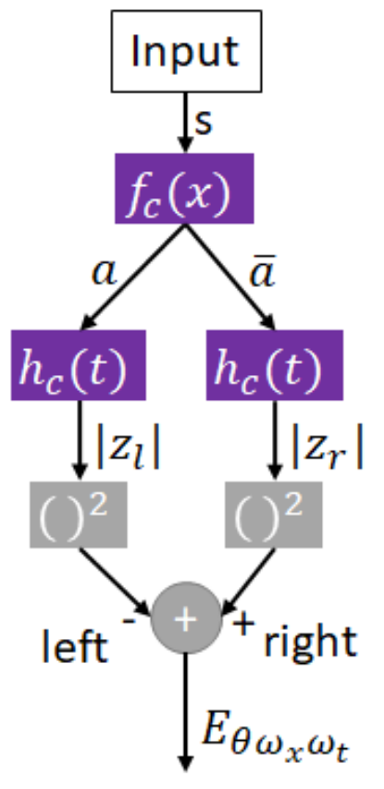
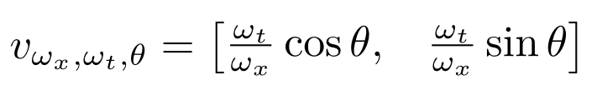
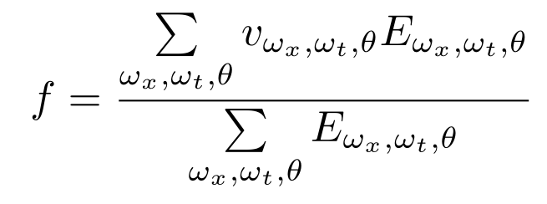

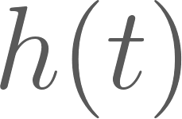
Estimating Optical Flow with RF
Input – spikes
sparse event-based DVS data
In the case of video frames, a separate graded spike is used to represent the intensity of each pixel.
Velocity
Optical flow
Estimate energy from input.
– spatial filter
– temporal filter

Slide 19
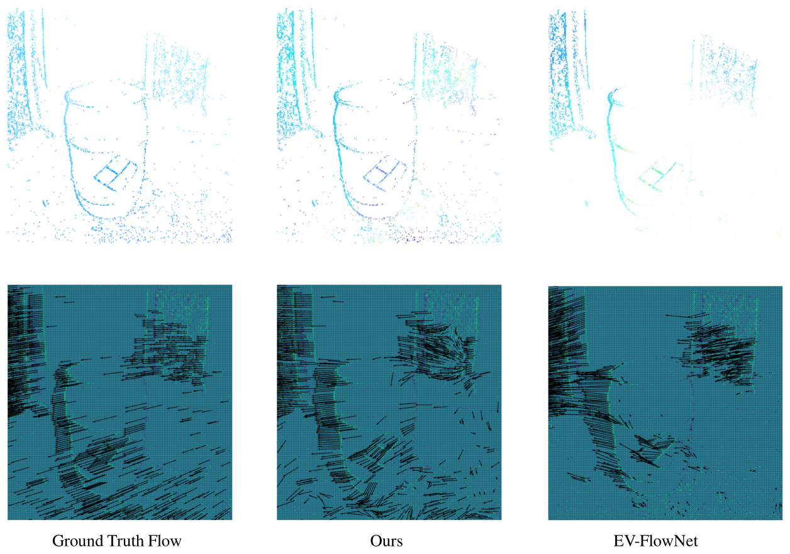
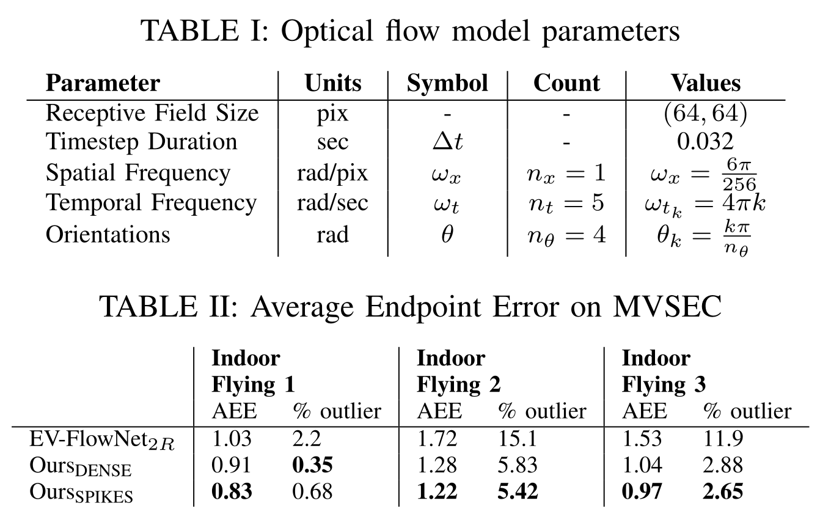
Estimating Optical Flow with RF. Results

Slide 20
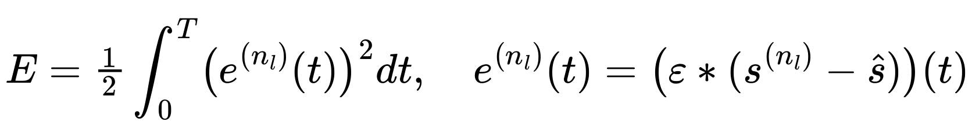
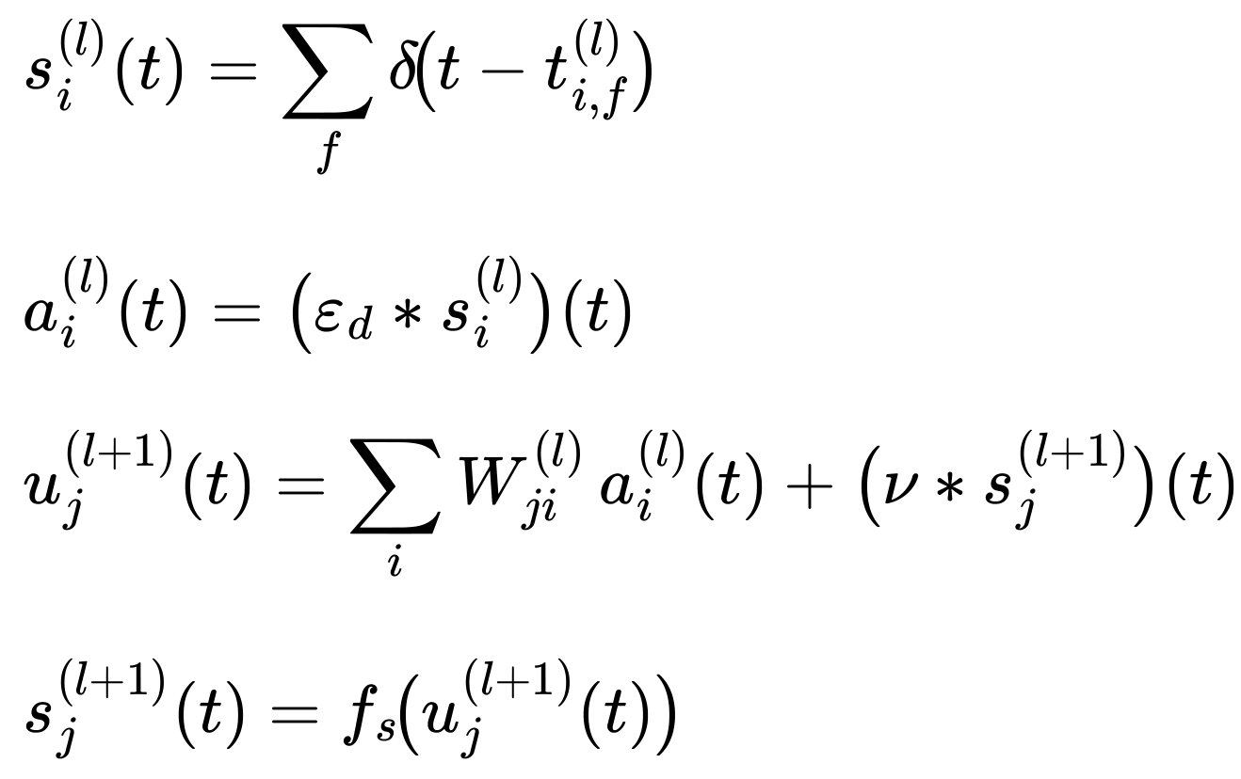
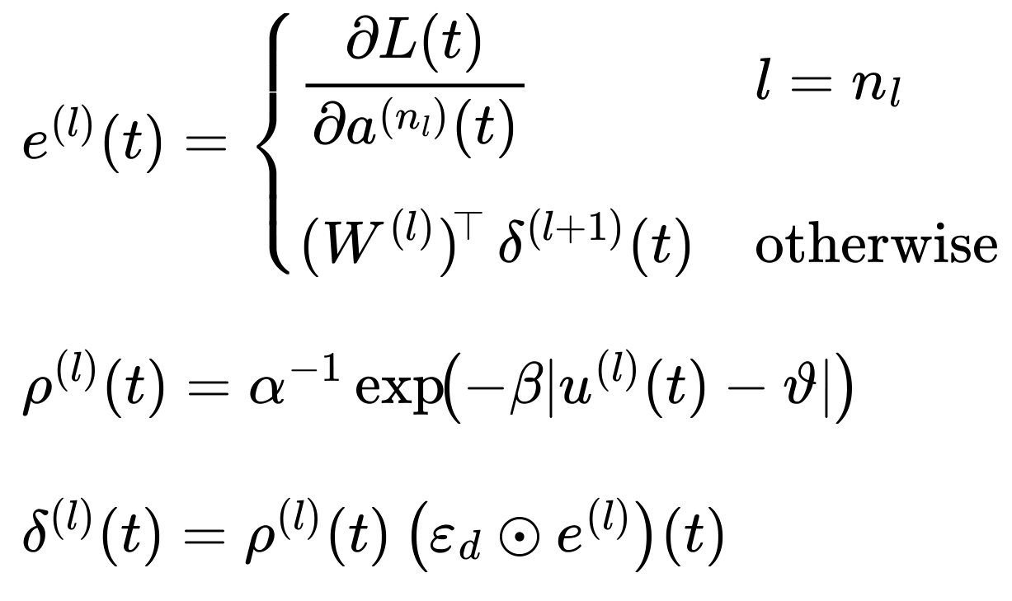
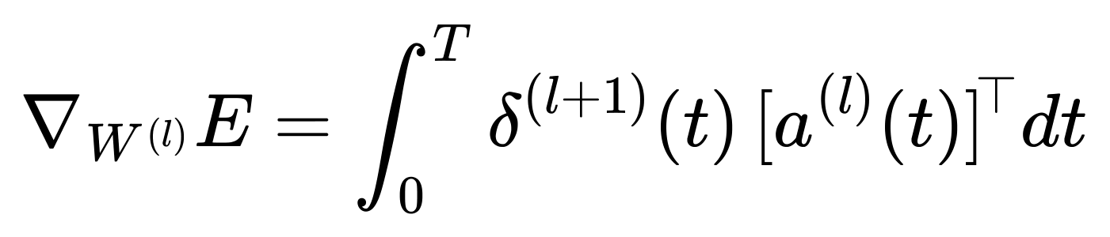
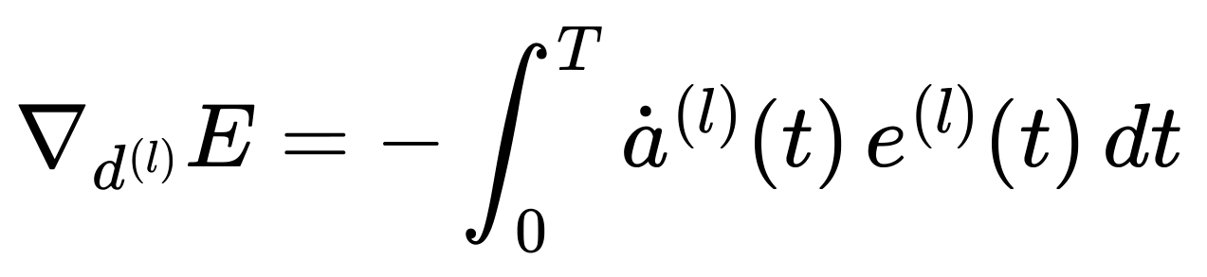
SLAYER

Slide 21
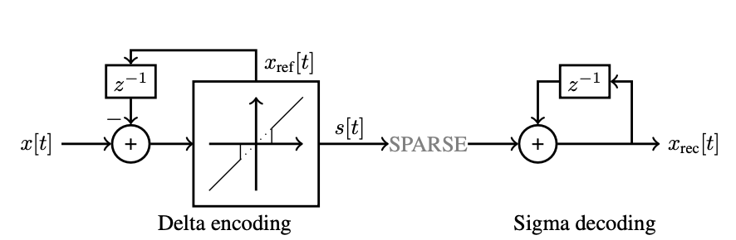
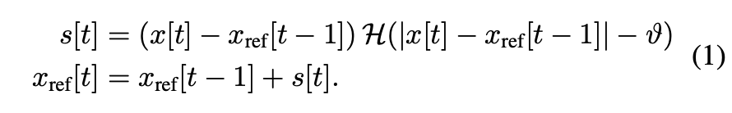
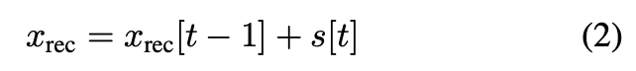
Efficient Video and Audio Processing with LOIHI 2
Since Intel Loihi 2 is suitable for RF networks and Sigma-Delta encapsulation:
Authors integrate these concepts into regular ANNs and benchmark Loihi 2 SNNs on Video and Audio tasks in terms of Efficiency and Delay VS NVidia Jetson and CPU

Slide 22
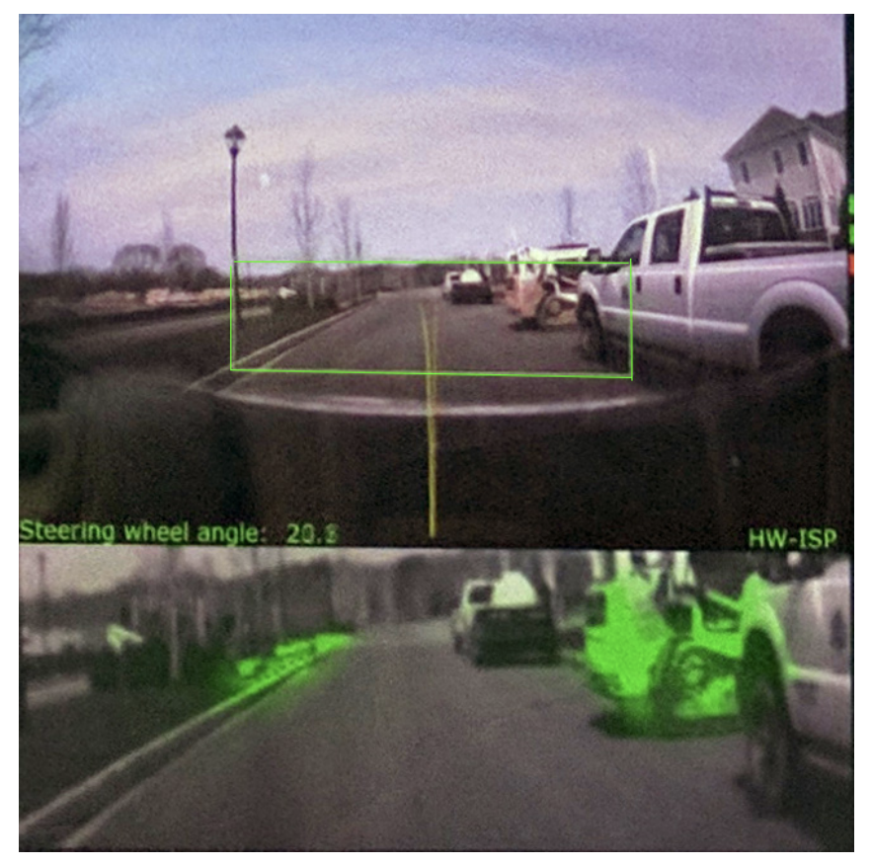
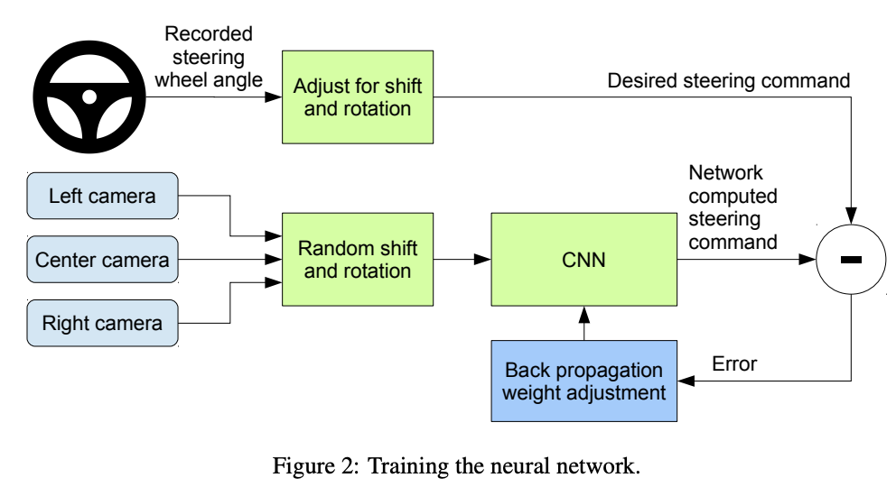
Efficient Video and Audio Processing with LOIHI 2
Video task setup:
The consecutive frames have high degree of temporal correlation -> Loihi 2 utilizes Sigma-Delta ReLU neurons.
MSE angle results(↓): 0.035 for Loihi 2 vs 0.025 8-bit quant. ANN (NVidia Jetson Nano)

Slide 23
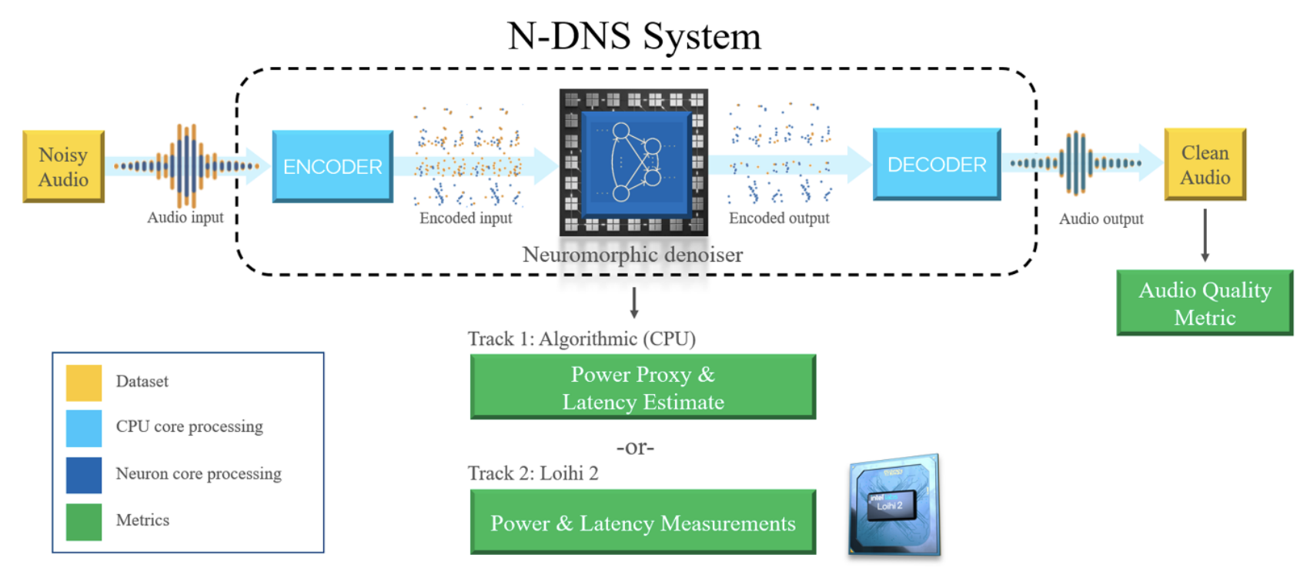
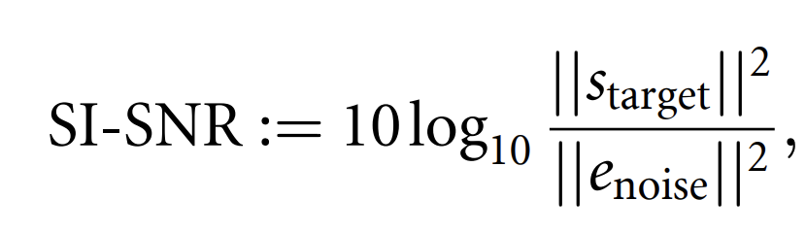

Efficient Video and Audio Processing with LOIHI 2
Audio denoising task setup:
Audio data is temporal and dense, 16kHz sampling rate means 16k measurements per second!
SI-SNR results(↑) : 12.5 for Loihi 2 vs 11.89 ANN baseline (NVidia Jetson Nano)
Metric:

Slide 24
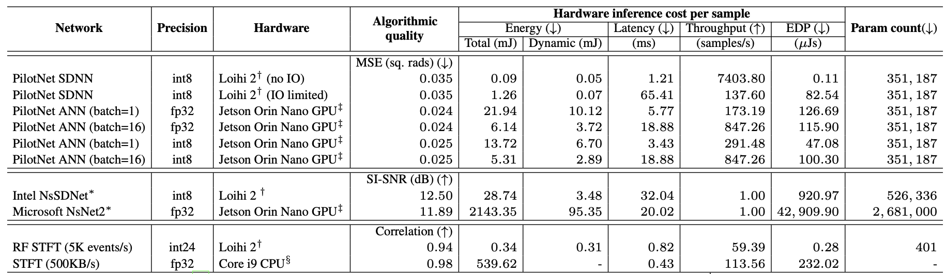
Efficient Video and Audio Processing with LOIHI 2
Results for Intel Loihi 2:
PilotNet Steering: up to 150x less Energy, 2.8x faster latency
Noise suppression: up to 74x less Energy, better SI-SNR, 526k vs 2.68M params
STFT: up to 1500x less Energy, 828x better EDP

Slide 25

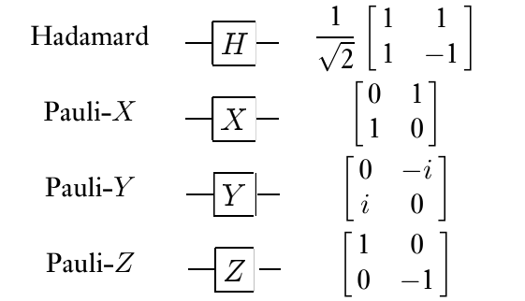
Briefly about Quantum Computing

